Slide 1

NYC PPP Loan Distribution
Group Members :
Ciara Spencer
Anne Ramer
Chris Barlow

Slide 2
Theme
The topic of our analysis centers on PPP (Paycheck Protection Program) Loan distribution data provided by the SBA
Based on research of other analysis and depictions of statistics on PPP Loan Data state-to-state and nationally, for our project we decided on the focus of our analysis to be on the economics of the loans in reference to industry, jobs retained, and five tier loan ranges for recipients of loans specific to NYC
Because the loans went to industry and corporations, our focus is on distribution in reference to industry in accordance with economic factors such as loan range, and jobs retained as sub-sectored by industry. Factors such as – whether higher loan range amounts within certain industries enabled retainment of more jobs. Our research analyses the data specific to NYC to check for alignment with published statistics that cite unfairness in loan distribution toward industry for their primary purpose of retaining jobs.

Slide 3
Coding Approach
https://github.com/cspence001/nyc_ppp_loan

Slide 4
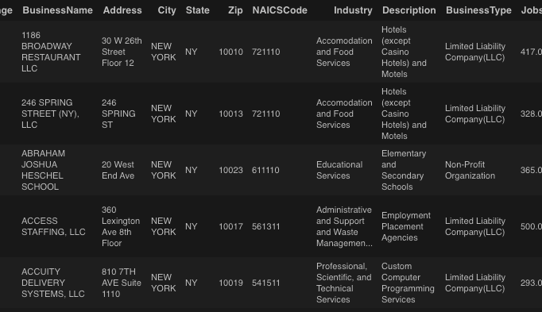
The Data

Slide 5
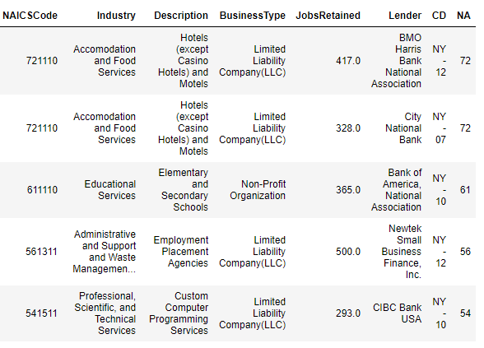
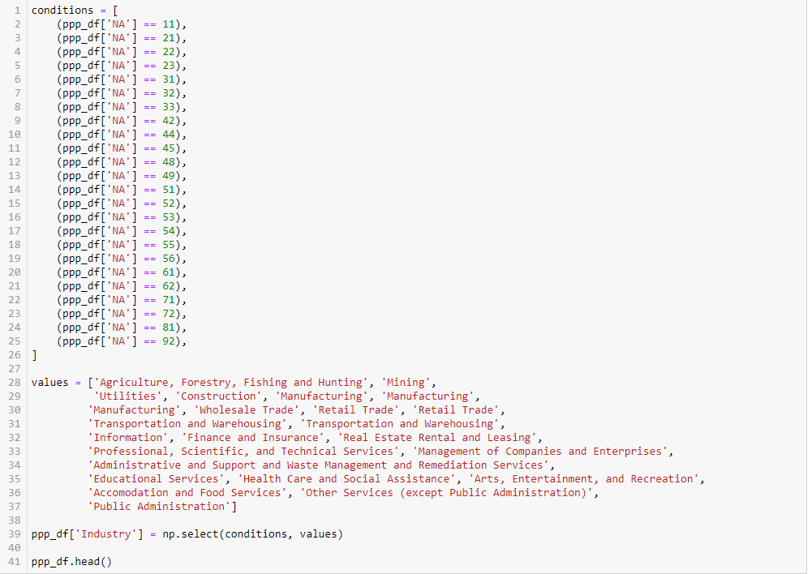
Data munging techniques

Slide 6
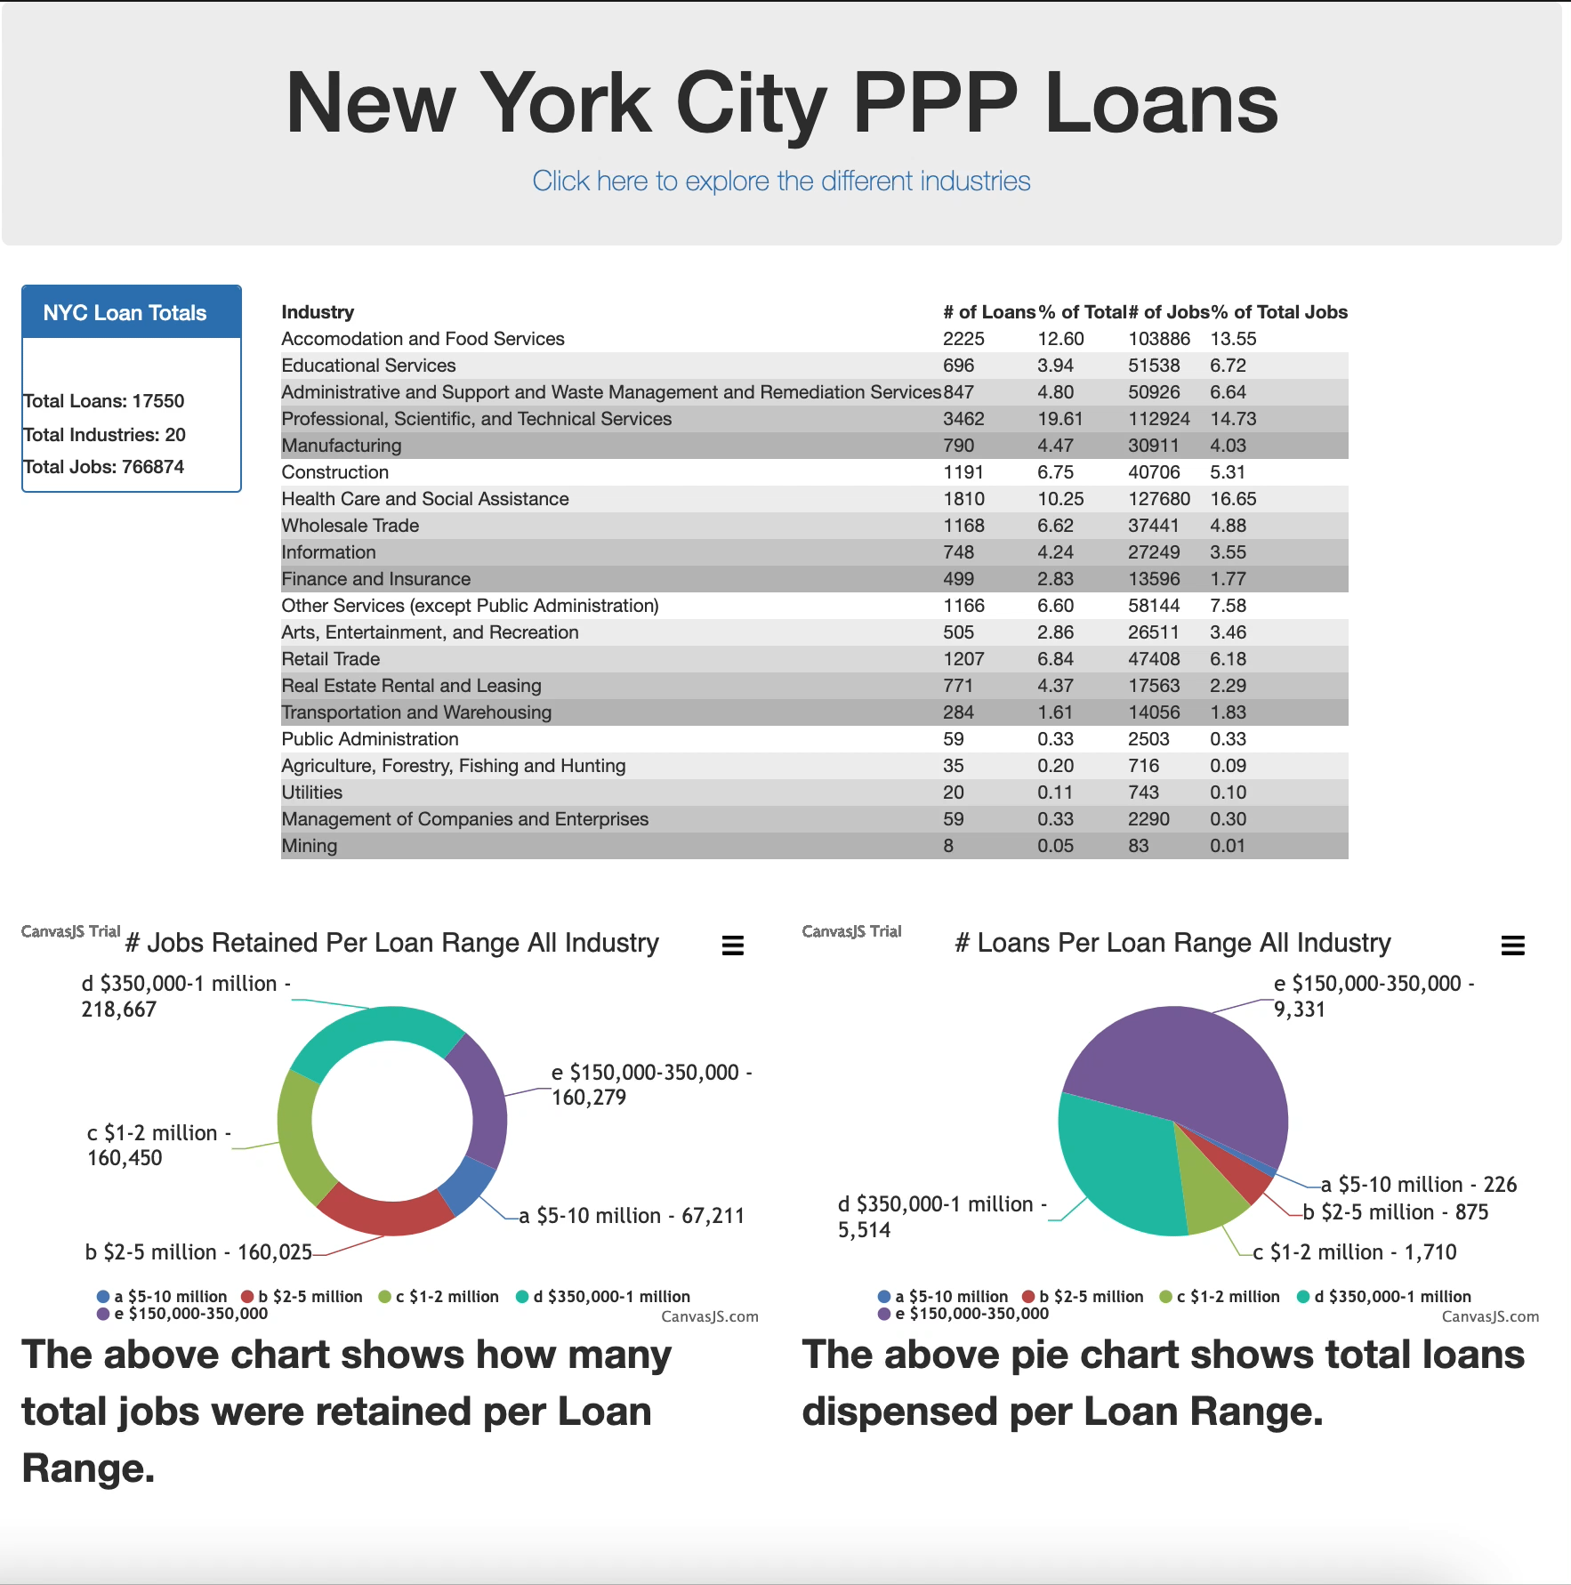
Final Visualization

Slide 7
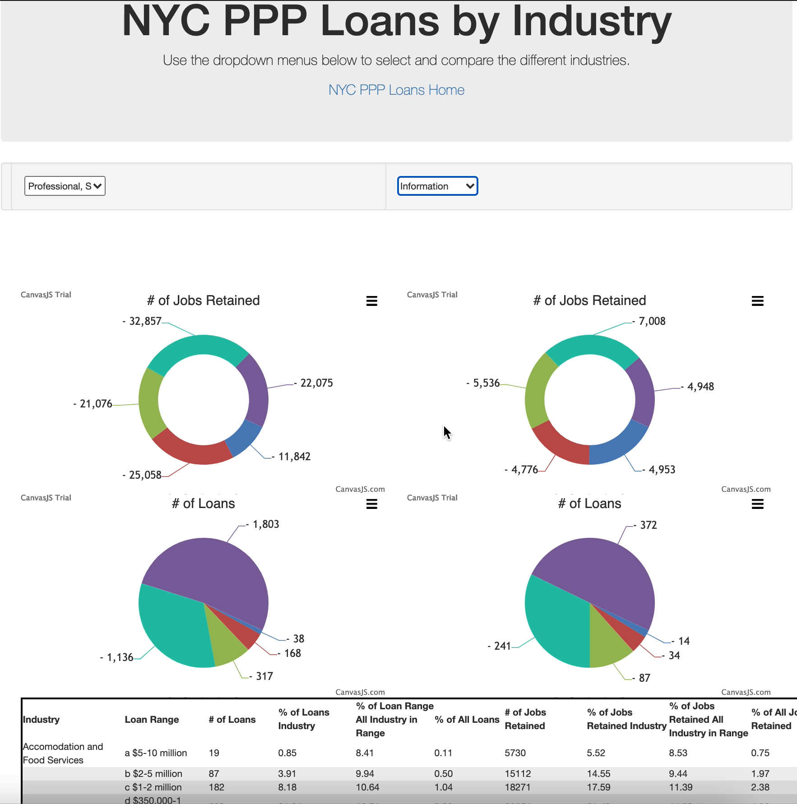
Final Visualization

